Slide 1

HR - ANALYTICS
MUSTAFA - THE DATA ANALYST

Slide 2


PROBLEM STATEMENT
Design a Power BI dashboard to track employee data for the HR team, including working hours, attendance, performance, and leaves %. The dashboard streamlined HR processes and increased efficiency.

Slide 3
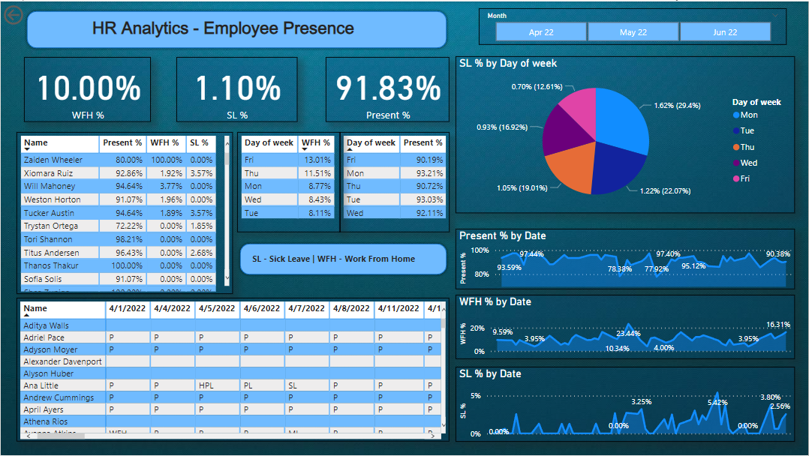
DASHBOARD

Slide 4
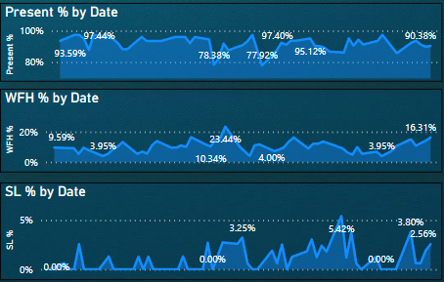
% RECORD
% WORK-FROM-HOME PREFERENCE
% SICK LEAVE OF EMPLOYEES
% PRESENT AT THE CURRENT TIME

Slide 5
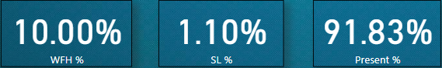
% RECORD
% WORK-FROM-HOME PREFERENCE
% SICK LEAVE OF EMPLOYEES
% PRESENT AT THE CURRENT TIME

Slide 6
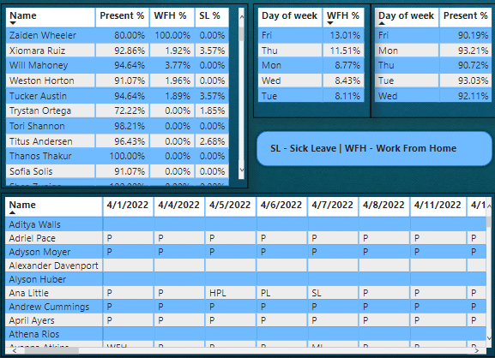
% RECORD
% WORK-FROM-HOME PREFERENCE
% SICK LEAVE OF EMPLOYEES
% PRESENT AT THE CURRENT TIME

Slide 7
THANK YOU
Email: canabisradarforbusiness@gmail.com
Phone(Whatsapp):+923494624108
Linkedin: www.linkedin.com/in/mustafatheanalyst/

